Slide 1
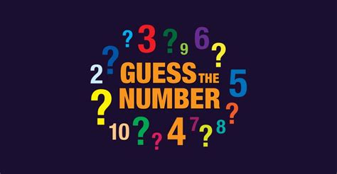

Slide 2

Define the Application
C / Rust / Go / Julia?
You think of a Number between x and y
numG™ will guess your number
In the rare event the guess® is wrong
Admit that number would have been better
Tell numG© to go lower or higher
You are happy and impressed

Slide 3

Possible Solutions
Start from lowest and go up
If it works its not stupid
Select a random number yourself
Save those wrong (and very rare) guesses and skip in the future
Distract the client with flirting
It has the desired end result
Start from lowest and go up 10 at a time
After all, if we skip it, you have to tell the program
Then we go 10 down and just go every number now
We are so smart

Slide 4
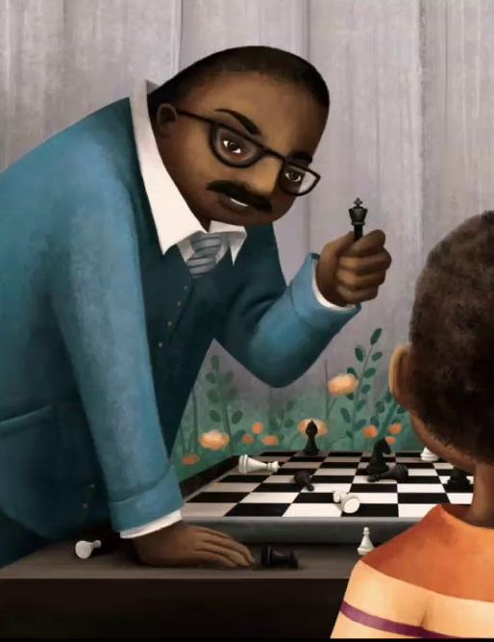
My Solution (Yours is better)
Divide current range by half
Guess that center point
We are too high?
We save last guess
Current range is lowest point to center point
Start from the top
We are too low?
We save last guess
Current range is center point to highest point
Start from the top
We guess correctly?
Dab on the haters? I guess…

Slide 5
Its time to end the boring stuff
And start our epic coding montage

Slide 6
Basic Program Structure
Language Syntax

Slide 7
Declare Data
Variables with Types / Strings and Integers

Slide 8
Give the user Feedback
Terminal output

Slide 9
Take Input from the user
Terminal interaction

Slide 10
Decide what to do now
Control flow / IF, WHILE / SWITCH

Slide 11

And now its time for you to
Do homework
What did you expect? Your mother?

Slide 12

Reseach Tasks
Print with different colors
Stop the while loop with a special input
Save all “wrong” guesses® and print them after finding the correct number
<- that’s you

